Slide 1
Mars Global Mosaic
Mars Global Mosaic: Mapping Lava Flows, Fluvial Channels, and Impact Craters in Visible and Infrared
REMOTE SENSING 2026 OCN 4704 · Logan M Edwards
Final Presentation · 22 October 2026

Slide 2
01
The question
Lava or water at Athabasca Valles?

Slide 3
The Question
Athabasca Valles was read as a water-carved outflow channel for decades, then reinterpreted as flood lava. Can a co-registered visible and thermal-infrared mosaic tell lava, water and impact landforms apart, and how far does the thermal infrared carry the answer?
One co-registered stack: Viking visible colour, THEMIS day and night infrared and HRSC/MOLA topography on a single grid over ±60° (86.6% of the surface)
Map the three landform families from it: lava flows, fluvial channels, impact craters
Test whether thermal infrared separates surfaces that visible light cannot
Score every product against something it never saw: held-out labels, the Robbins crater database, the USGS geologic map, calibrated TES thermal inertia

Slide 4
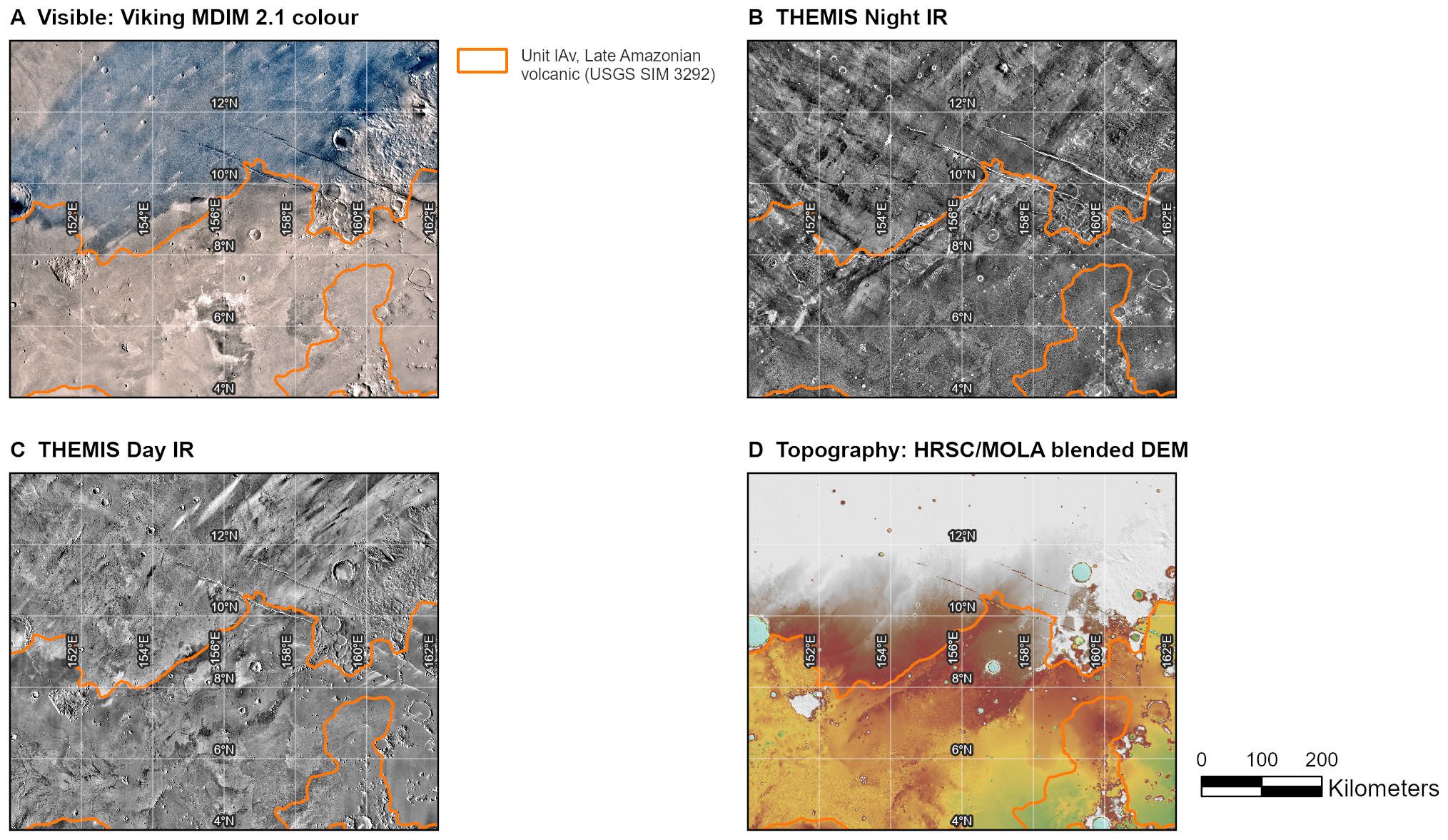
Athabasca Valles: the hook
150–162°E, 4–14°N: unit lAv, Late Amazonian volcanic (outlined)
Catalogued craters: 1,122 per million km² on lAv, 1,760 and 2,183 on the older units
Viking albedo tracks calibrated inertia here (r −0.55); the diurnal-contrast index does not
PROJECT-KNOWLEDGE.md §14.4, §42, §63

Slide 5
02
Building the mosaic
Four datasets, three coordinate frames, one grid

Slide 6
Relevant Spectral Bands
Band or product | Wavelength | Cell | What it contributes
Viking MDIM 2.1 R, G, B | visible, ~0.4–0.7 µm | 232 m | Albedo: bright dust against dark basalt. Keeps real regional differences (§28.10).
THEMIS Day IR (v12) | thermal IR, 6.8–14.9 µm | 100 m | Daytime temperature: bright in visible = cool by day (r −0.49 at Ius, §18.3).
THEMIS Night IR (v14, ±60°) | thermal IR, 6.8–14.9 µm | 100 m | Night temperature: rock holds heat. The most independent band, |r| ≤ 0.12 (§18.3).
HRSC/MOLA blended DEM | altimetry + stereo | 200 m | Slope in degrees, local relief, hillshade, flow routing, closed-depression depth (§20).
Diurnal contrast index | day − night, relative | 100 m | A local material discriminator inside one area; not thermal inertia, not planet-wide (§24, §28.10).

Slide 7
Why Fuse Them: Three Independent Dimensions
Ius Chasma, r | Viking R | Viking G | Viking B | Day IR | Night IR
Viking R | 1 | +0.960 | +0.925 | −0.486 | −0.121
Viking G | +0.960 | 1 | +0.993 | −0.496 | −0.085
Viking B | +0.925 | +0.993 | 1 | −0.488 | −0.068
Day IR | −0.486 | −0.496 | −0.488 | 1 | +0.105
Night IR | −0.121 | −0.085 | −0.068 | +0.105 | 1
Three visible bands are one dimension (r 0.93–0.99); day IR adds a second, night IR a third. Effective dimensionality ≈ 3: the measured case for fusing them. PROJECT-KNOWLEDGE.md §18.3

Slide 8
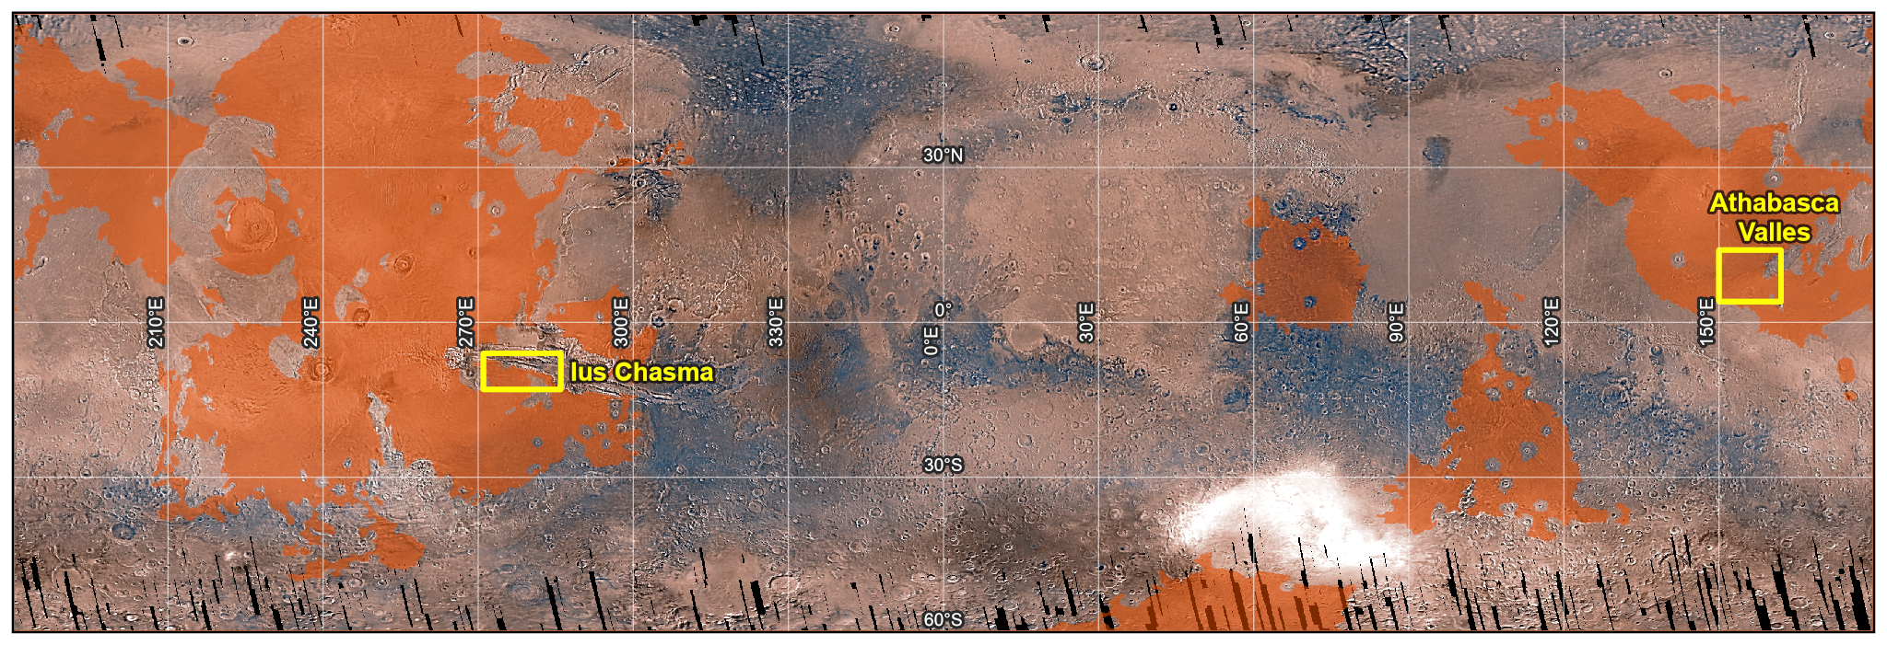
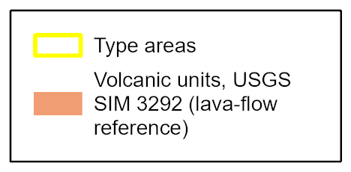
Where: the ±60° extent and the two type areas
±60° latitude: the THEMIS night mosaic's coverage, 86.6% of the surface
Ius Chasma (canyon and tributaries) and Athabasca Valles (flood lava)
Orange: the geologic map's volcanic units, the lava-flow reference
PROJECT-KNOWLEDGE.md §14.3, §16, §44

Slide 9
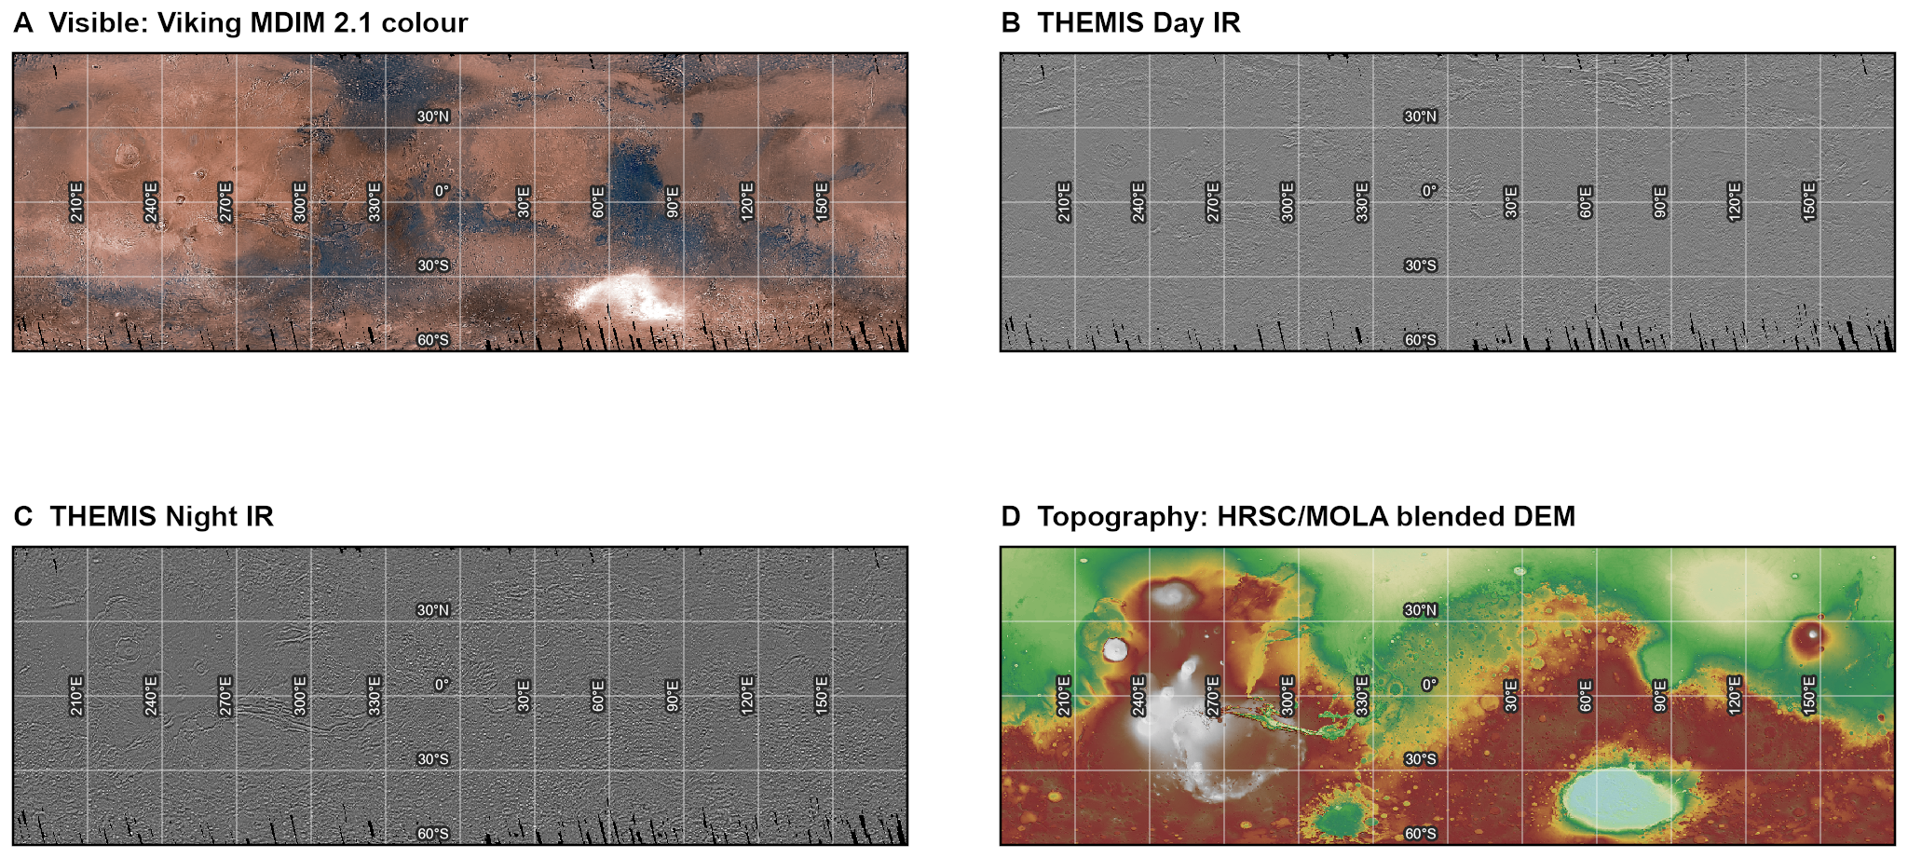
The mosaic at ±60°
THEMIS on a 180° meridian, Viking on 0°, the DEM in degrees: a window read at face value lands half a planet away
One grid read off the night mosaic: day and night are never resampled; the DEM sits on it to 10 µm
Composite Bands failed four times globally by 13 Sep; on bounded extents it took 8.8 s
PROJECT-KNOWLEDGE.md §4, §8, §18, §28.1, §28.2

Slide 10
03
The thermal pair
What it can and cannot do

Slide 11
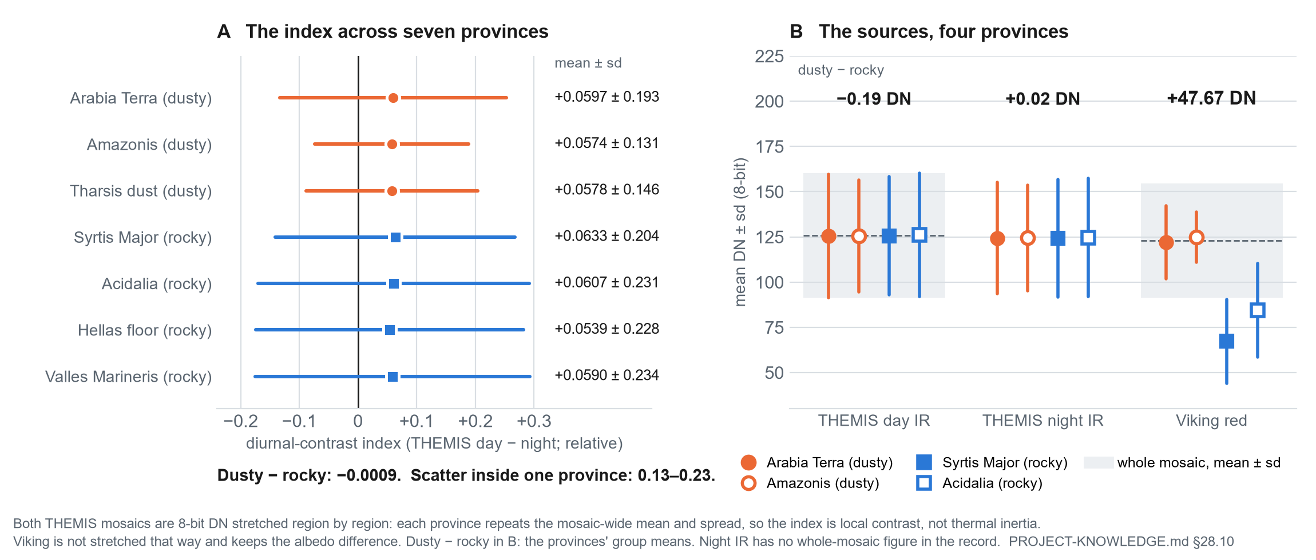
Across ±60° the THEMIS mosaics carry local contrast
Viking red separates dusty from rocky provinces by 47.67 DN; THEMIS day and night by −0.19 and +0.02
Every province repeats the mosaic-wide mean and spread: stretched region by region
So the diurnal-contrast index is not thermal inertia and is never compared across the planet
PROJECT-KNOWLEDGE.md §24.1, §28.10

Slide 12
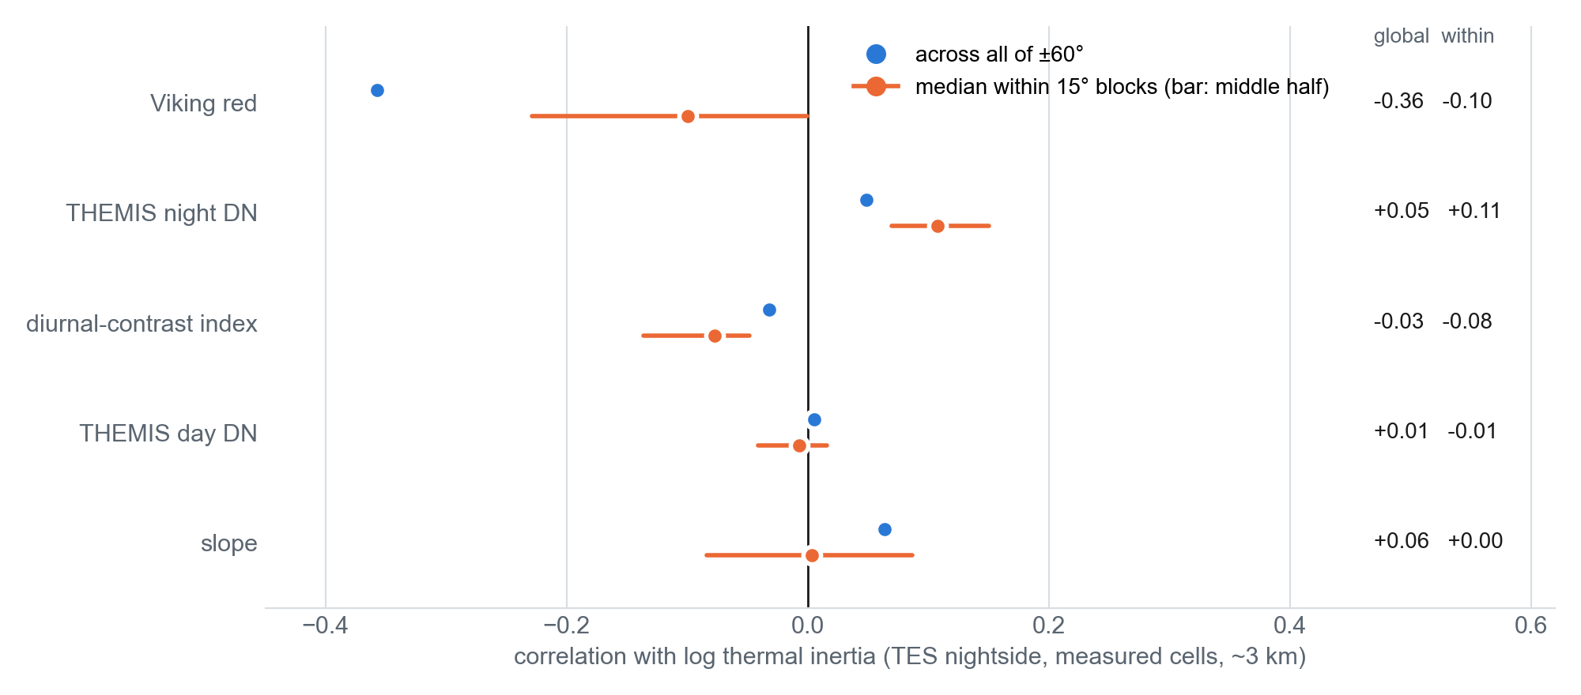
Checked against calibrated thermal inertia (TES)
Viking albedo tracks TES inertia across the planet (r −0.31 dayside, −0.36 nightside)
Night IR and the index: a weak signal inside 15° blocks only (|r| ≈ 0.1); day IR none
The material signal at 3 km is in visible albedo
PROJECT-KNOWLEDGE.md §41, §42.4, §43.1

Slide 13
04
Landforms
Craters, channels, lava flows

Slide 14
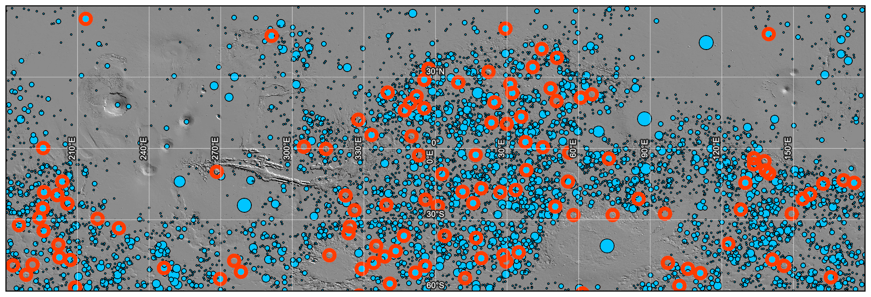
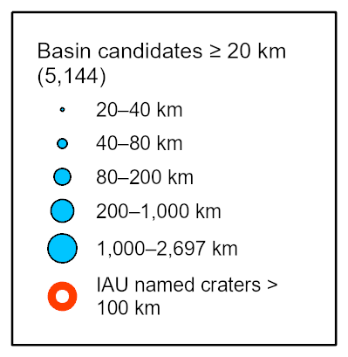
Basins ≥ 20 km: the large craters
5,144 closed basins ≥ 20 km from fill depth in 48 s at 1.6 km
68% of 117 IAU craters ≥ 100 km recovered; diameter error median +2.2%
Breached craters are invisible by construction (Oudemans is the type case)
PROJECT-KNOWLEDGE.md §26.3, §28.11

Slide 15
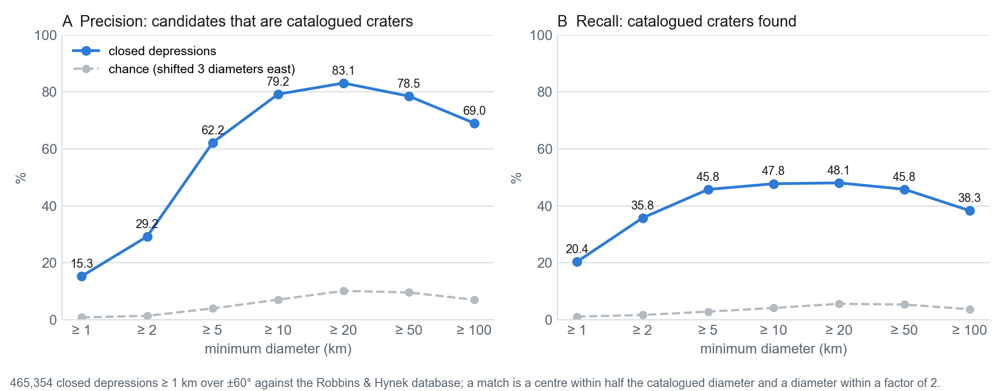
Closed depressions ≥ 1 km against the Robbins database
465,354 closed depressions ≥ 1 km from an 11-hour pass at 200 m
Precision 15.3% at ≥ 1 km, 62.2% at ≥ 5 km, 83.1% at ≥ 20 km; chance under 11%
Recall levels off near half: degraded and breached craters stay hidden
Below ~5 km the density follows the DEM's sharpness (r −0.11 with Robbins): prompts, not an inventory
PROJECT-KNOWLEDGE.md §53.4, §53.6, §54.4

Slide 16
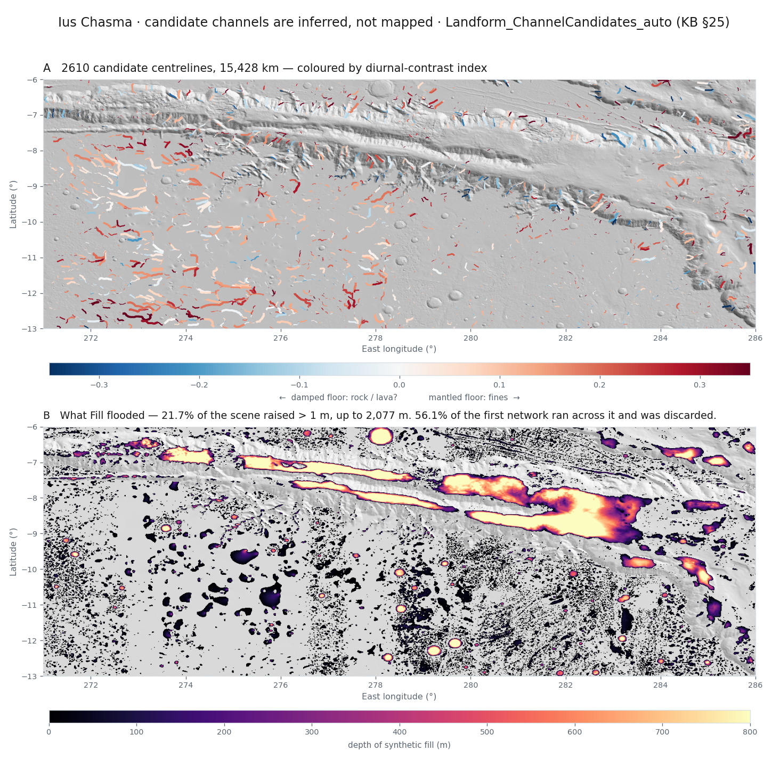
Channels: the Fill trap at Ius Chasma
Fill raised the canyon floor up to 2,077 m into a synthetic lake
56.1% of the first network routed across ground that does not exist
A fill mask (fill − DEM ≤ 1 m) removes it; 188 of 2,610 candidates are steep and rock-floored
PROJECT-KNOWLEDGE.md §25.1, §25.2

Slide 17
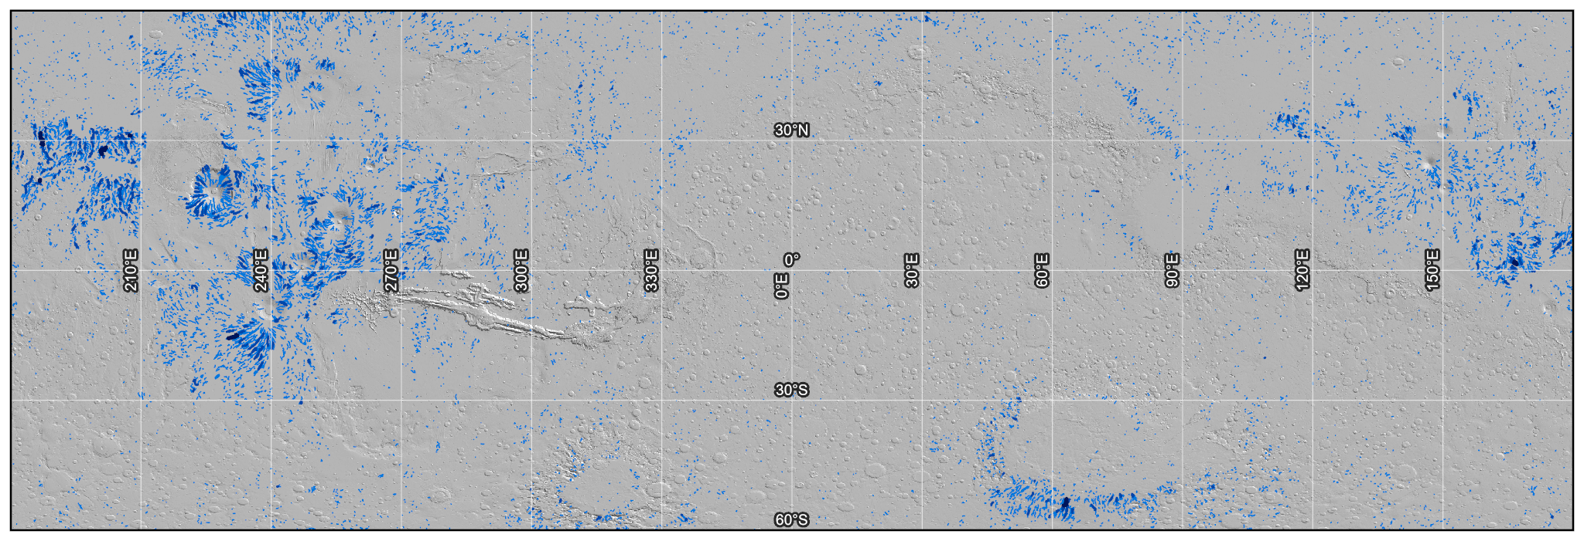
Channels across ±60°
969,822 routed segments; 60.5% of stream cells discarded as fill artefact
89.8% lie on ground under 2°: plateau channels are DEM noise
Channel order follows the threshold, about one order per tenfold (T7): a setting, not a measurement
PROJECT-KNOWLEDGE.md §47.4, §53.6, §54.4

Slide 18
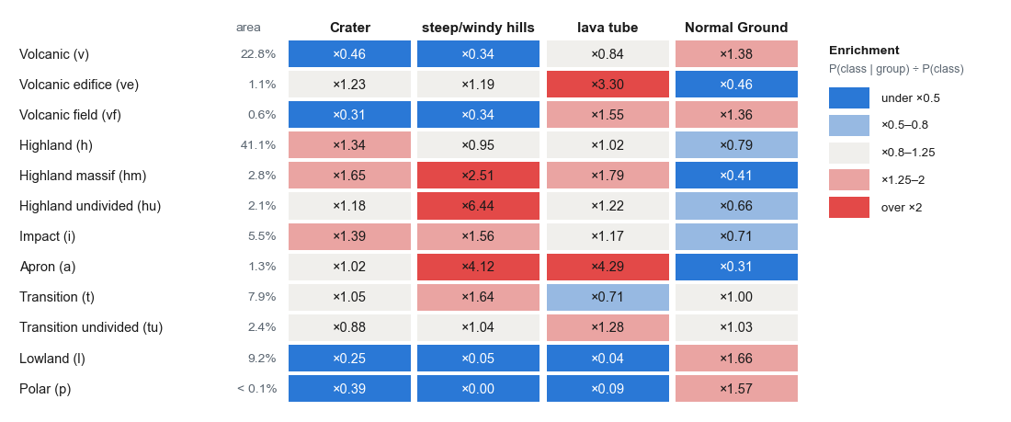
Lava flows: the classes against the geologic map (T8)
'Lava tube' sits on volcano flanks and aprons (×3.30, ×4.29), not on volcanic plains (×0.84)
76% of the volcanic plains come out Normal Ground
Lava flows are therefore taken from the geologic map's volcanic units
PROJECT-KNOWLEDGE.md §43.2, §43.3, §57.1

Slide 19
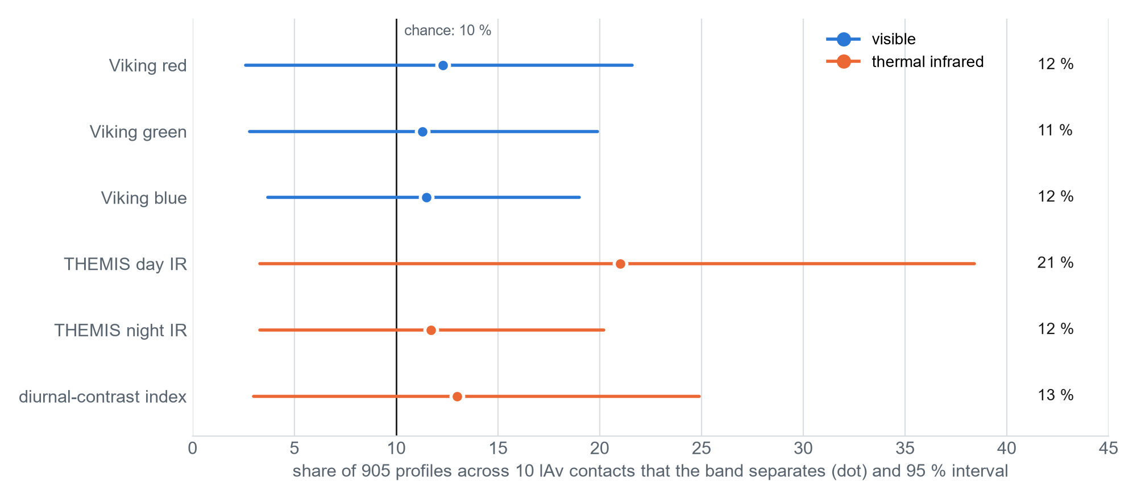
Do the infrared mosaics show flow margins Viking misses? (H1)
905 profiles across 10 lAv contacts at Athabasca, each against a random-line null (10%)
Day IR separates 21.0%, Viking red 12.3%: a lean toward H1, interval −1.7 to +18.1 pt
A 1:20 M map's contacts are kilometres wide: H1 needs margins digitised at 100 m
PROJECT-KNOWLEDGE.md §47.2

Slide 20
05
Classification
Scored on labels the model never saw

Slide 21
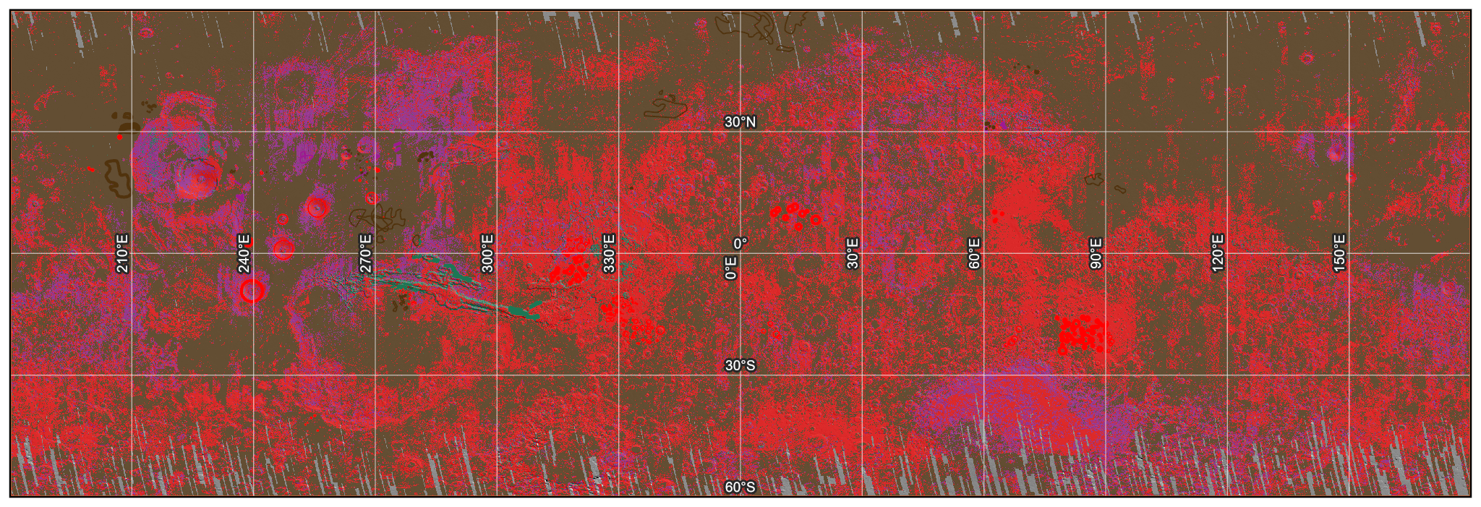
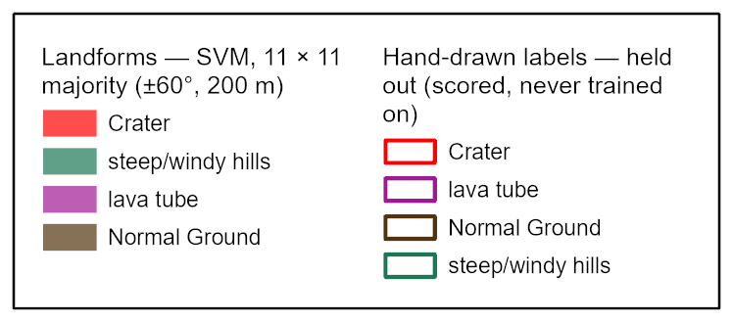
The published landform map at ±60°
SVM on 512 hand-drawn polygons, split by whole 15° blocks: 329 train, 183 held out
200 m, 11 × 11 majority filter: 73.8%, κ 0.58 held out (one class everywhere: 58.6%)
Normal Ground and cratered terrain solid; lava tube is not a result (user's 2%)
PROJECT-KNOWLEDGE.md §31.3, §55.3, §57

Slide 22
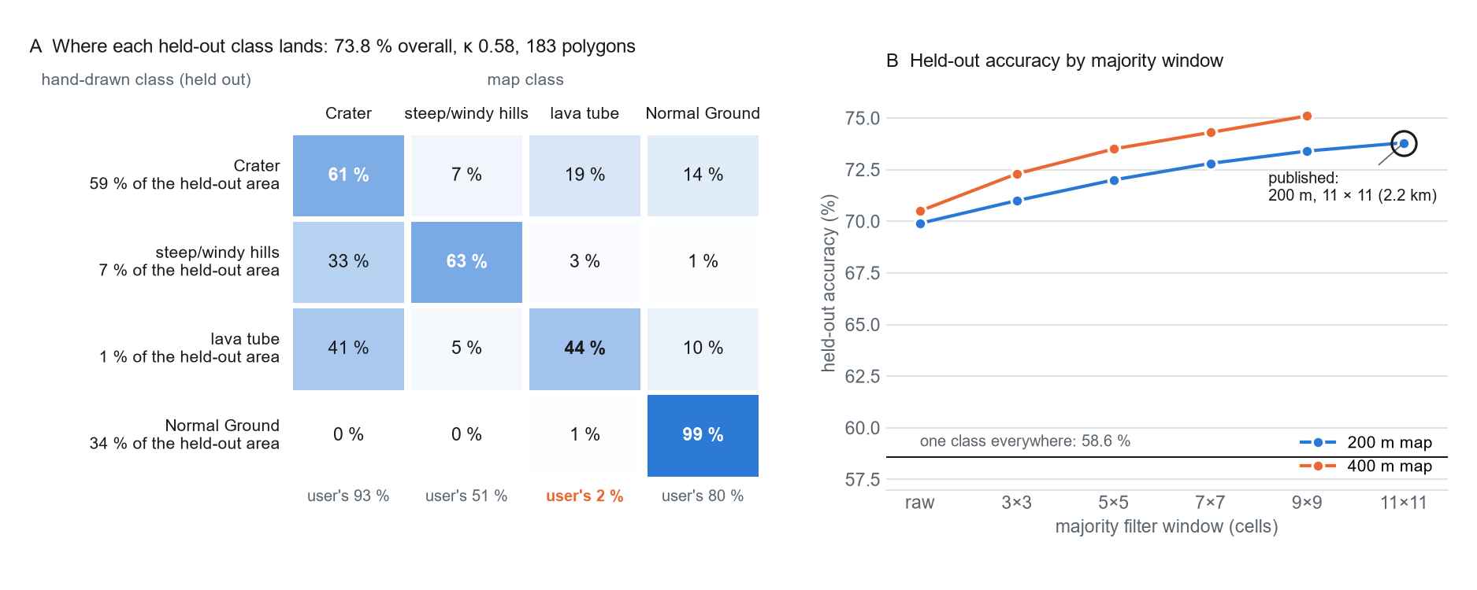
Where each held-out class lands
Smoothing raises every score because the labelled polygons are large; the window is set by feature size (~2 km), not by score
Halving the cell to 200 m bought no held-out accuracy
PROJECT-KNOWLEDGE.md §32.2, §55.3, §57

Slide 23
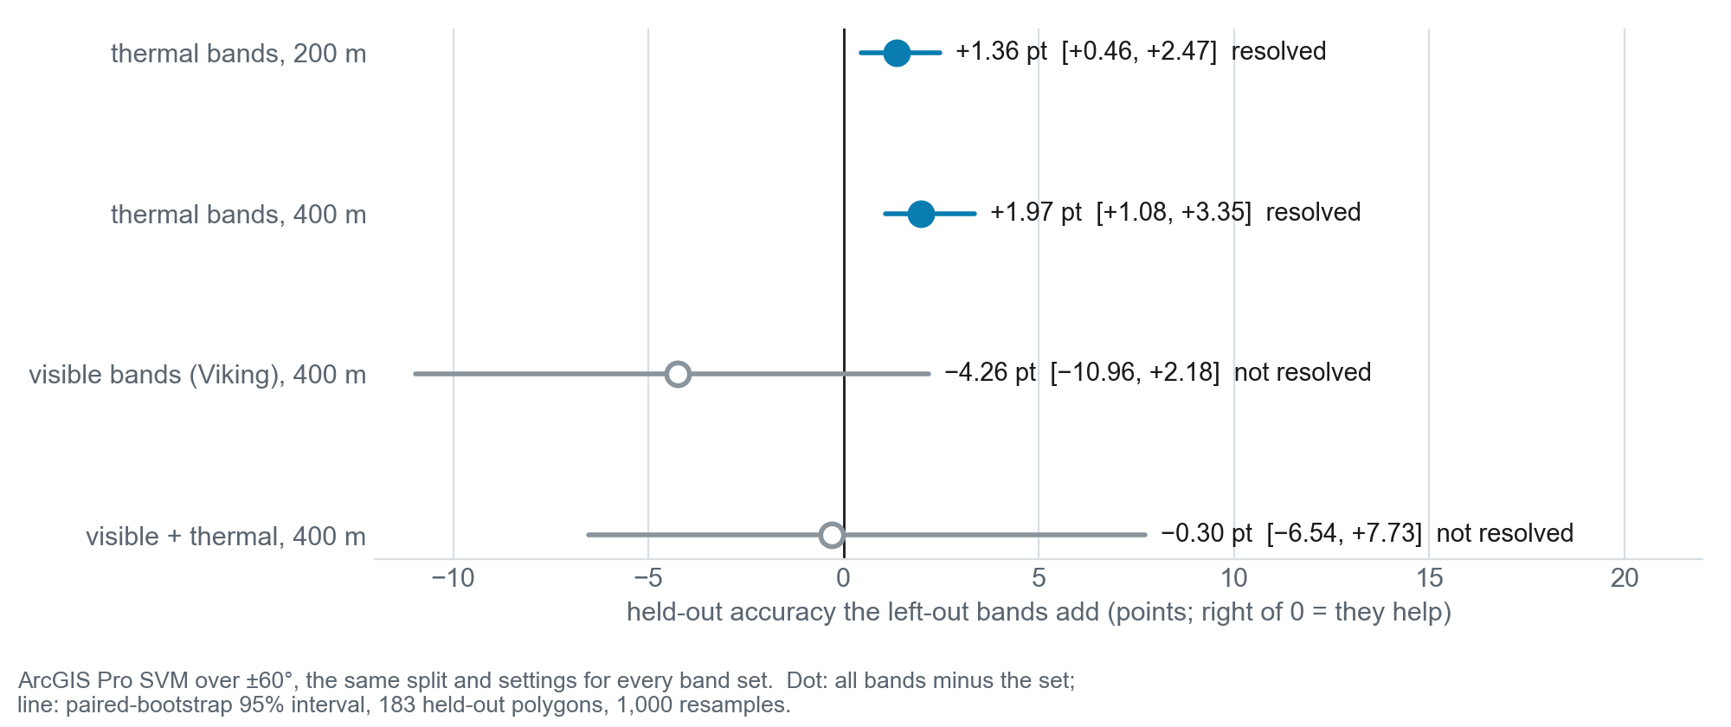
Does thermal infrared improve the classification? (T1)
Thermal adds +1.36 pt at 200 m and +1.97 at 400 m, both intervals above 0 (numpy: +1.3)
It helps craters and hills and hurts lava tube
Terrain alone ties the score but makes a poor crater map: the classes are landform classes
PROJECT-KNOWLEDGE.md §40.1, §56, §56.1

Slide 24
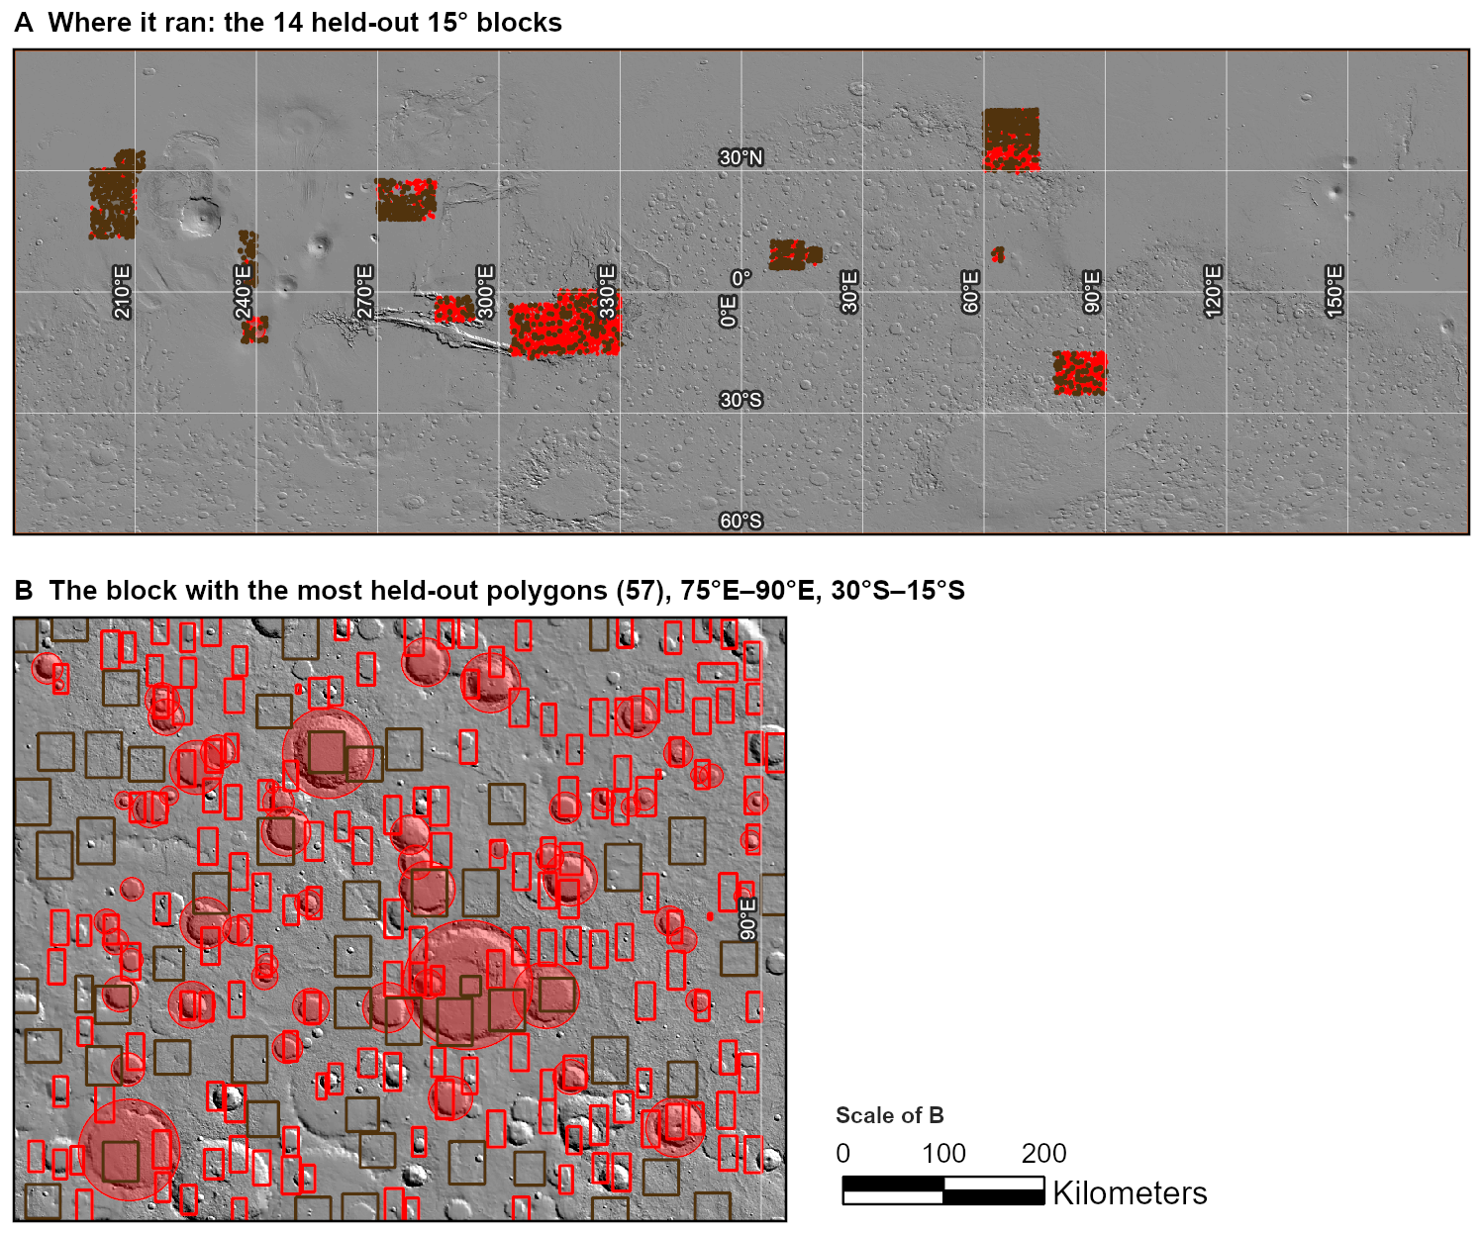
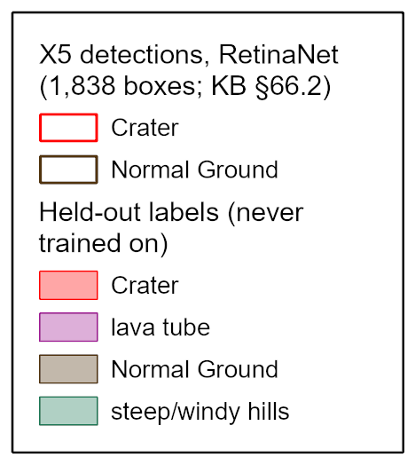
Deep learning, 1: a box detector
RetinaNet on the 7-band stack, trained on the training blocks only
Crater: 41.9% of held-out polygons found, 87.6% of boxes right (always Crater: 71.1%)
Hills and lava tube never named; retrained unfrozen for 30 epochs, Normal Ground recall fell to 4.5%
PROJECT-KNOWLEDGE.md §66.1, §66.2, §66.5

Slide 25
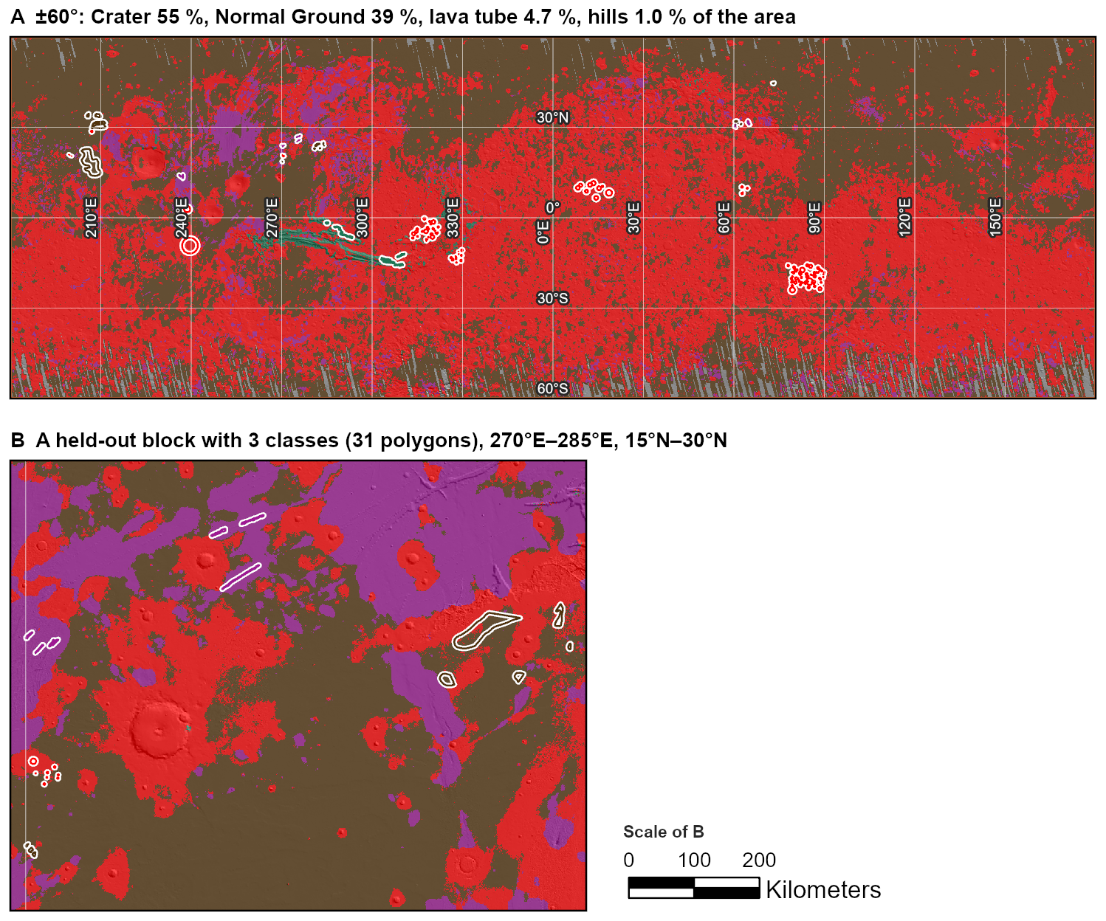
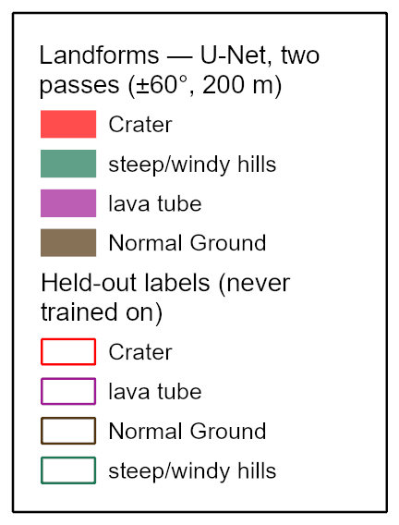
Deep learning, 2: a U-Net maps terrain provinces
Pixel classifier on the same stack and labels, over all of ±60°; a second pass 128 px offset removes its tile seams (ratio 8.6–9.2 → 1.2)
Held out 98.9%, κ 0.980; lava tube user's 77.1% against 2.4%
Provinces, not features: 'Crater' covers 82.6% of the ring round named craters
PROJECT-KNOWLEDGE.md §66.6–66.9

Slide 26
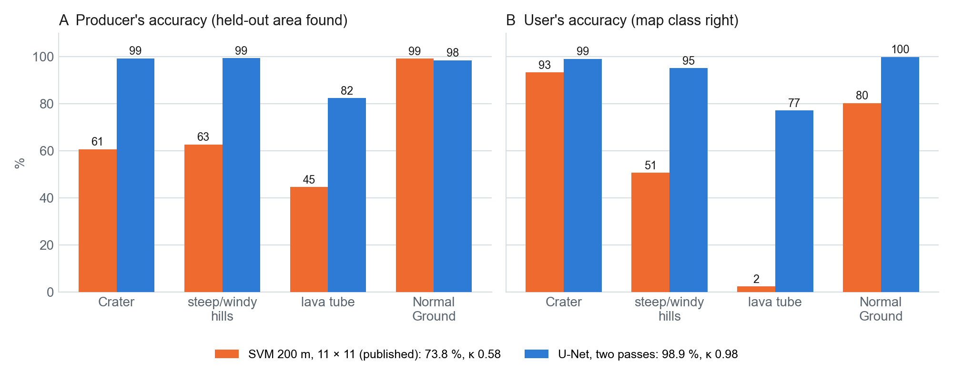
The two maps under one scorer
The U-Net agrees with the hand-drawn areas at province scale; the SVM separates craters from their surroundings slightly better (57 / 46% against 91 / 83%)
Elevation alone reproduces 68% of the U-Net map, 55% of the SVM map
The SVM map stays the published landform map; the U-Net map stands beside it
PROJECT-KNOWLEDGE.md §57, §66.7, §66.8, §66.9

Slide 27
06
What It Adds Up To
The hypotheses, the limits, the answer

Slide 28
The Hypotheses and Tests
 | Claim | Verdict | KB
H1 | Day IR shows lava-flow margins that Viking misses | Not supported at 1:20 M: day IR 21.0%, Viking red 12.3%, chance 10%; the difference's interval includes 0 | §47.2
H2 | Fluvial and volcanic channels separate on gradient and thermal response | Not supported at stage 1: the volcanic window's channels are shallower (1.4 against 10.2 m/km); thermal AUC 0.50 | §51.1
H3 | The composite gives more stable classes than any single input | Not supported: the composites are the least reproducible inputs (ARI 0.40 against 0.61–0.89) | §47.3
H4 | Crater rims from DN gradient recover the large IAU craters | Answered by another method: fill depth recovers 68% of 117 craters ≥ 100 km | §28.11
T1 | Thermal IR improves the landform classification | Yes, a little: +1.3 pt (numpy), +1.36 and +1.97 pt (Pro SVM), every interval above 0 | §40.1, §56
T3 | The THEMIS pair tracks calibrated thermal inertia | Weakly and only locally (|r| ≈ 0.1 within 15° blocks); Viking albedo carries the regional signal (r −0.36) | §43.1

Slide 29
Limits
The thermal signal is weak where it can be checked: The held THEMIS mosaics are 8-bit products stretched region by region: no calibrated thermal inertia, and against TES only |r| ≈ 0.1 inside 15° blocks. In the classification thermal adds 1.3–2.0 points (§24, §28.10, §43.1, §56).
The landform classes are terrain classes: Slope and relief alone match all seven bands; 'lava tube' marks volcano flanks, not lava plains (§40.1, §43.2).
Five 'Crater' labels are volcanoes: Arsia Mons alone is 31% of the held-out Crater area; one held-out label overlaps a training one by 51.5 km² (§68.2).
Closed depressions are not a crater count: Below ~5 km most are not catalogued craters, and breached craters are invisible; Robbins is the crater reference (§26.3, §53.4).
Channels and orders are DEM-limited: Fill floods closed basins; 89.8% of ±60° channels lie under 2°; the stream order is a setting (§25.1, §47.4, §54.4).
The review has not started: The three digitising classes hold 0 rows; 0 of 9,287 candidates are reviewed, so H1 and H2 wait for digitised margins and channels (NEXT-STEPS.md §6).
A held-out test spent once: Any further tuning of the deep-learning models needs validation blocks of its own (§66.5).

Slide 30
Conclusions
Four global products now share one co-registered grid over ±60°; the co-registration that failed four times works
Visible albedo, day IR and night IR are three nearly independent dimensions, but the THEMIS mosaics carry local contrast only, and calibrated inertia follows Viking
Craters ≥ 5 km are mostly recovered as closed depressions (62.2% precision); smaller ones and breached craters are not
The published landform map scores 73.8%, κ 0.58 on blocks it never saw; thermal adds a resolved 1.4–2.0 points
A U-Net reaches 98.9% as a terrain-province map; lava flows still come from the geologic map

Slide 31
What Next
Review the 9,287 machine candidates at Ius Chasma and Athabasca Valles; draw breached craters and lava margins
Retest H1 on margins digitised at 100 m and H2 on reviewed channels with their origin set
Seven classes (D17): impact craters only, plus volcanic edifice, apron and fluvial channel; both maps scored on the same held-out polygons
Material labels, not landform labels, to price the thermal bands; calibrated THEMIS products where they exist
Validation blocks of their own before any further deep-learning tuning
Every map, script and model: github.com/loggger101/Mars_Terrestrial_GlobalMosaic_GIS-Data, release data-2026-10-21 (CC BY 4.0 data, MIT scripts)

Slide 32
Questions?
Mars Global Mosaic: Mapping Lava Flows, Fluvial Channels, and Impact Craters in Visible and Infrared
Logan M Edwards · REMOTE SENSING 2026 OCN 4704

